Slide 1
Milestone 4
File created on: 2/25/21 4:50:45 AM CST

Slide 2
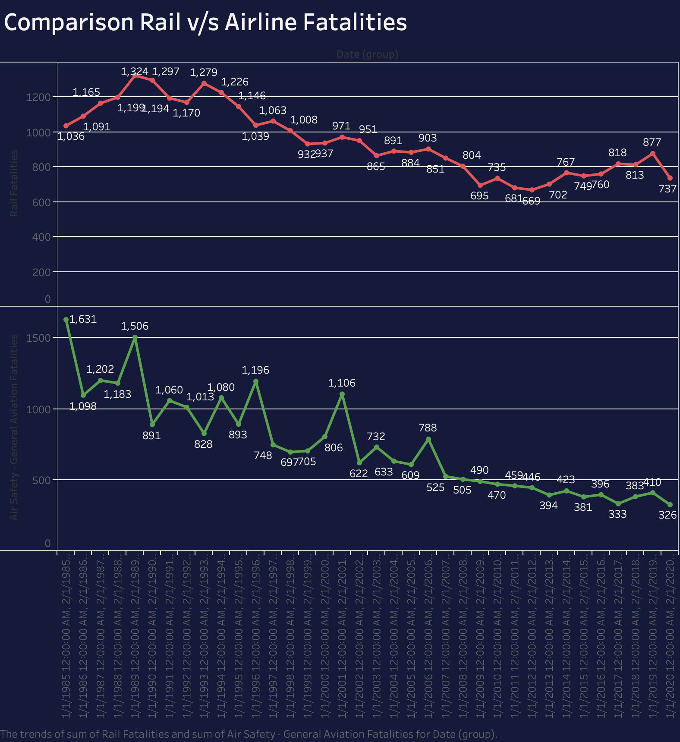

Slide 3
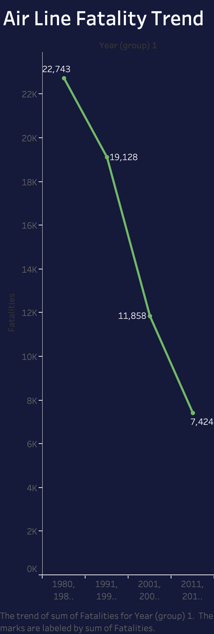

Slide 4
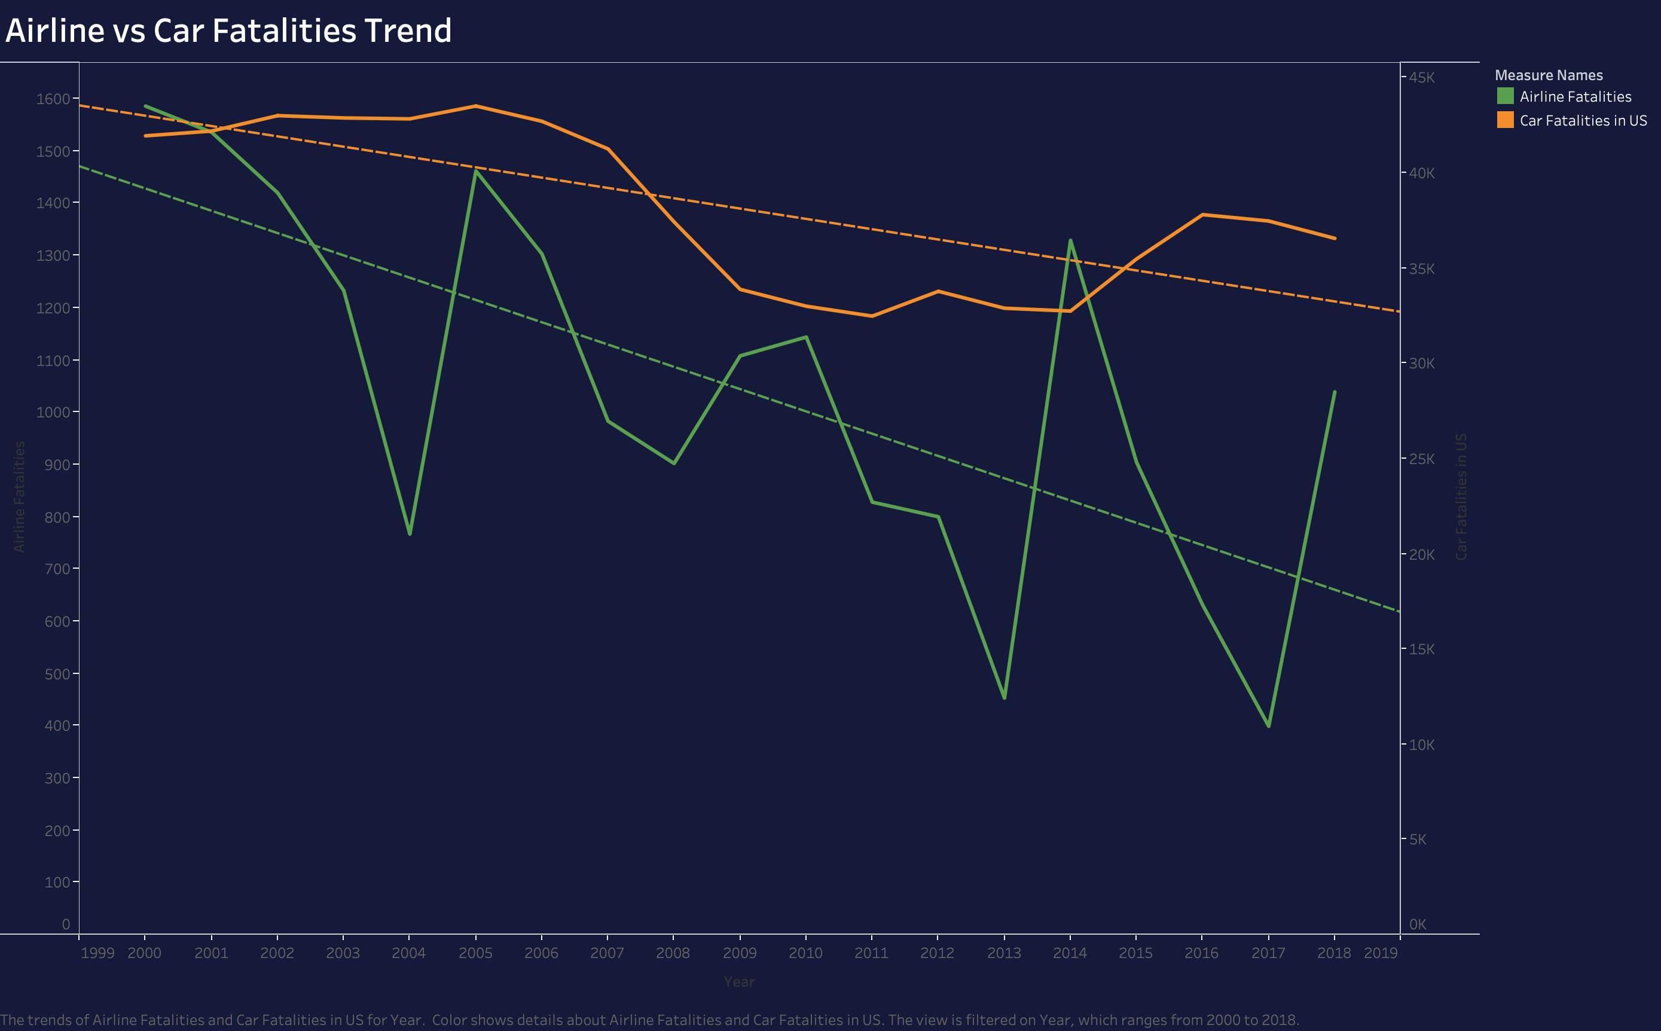

Slide 5
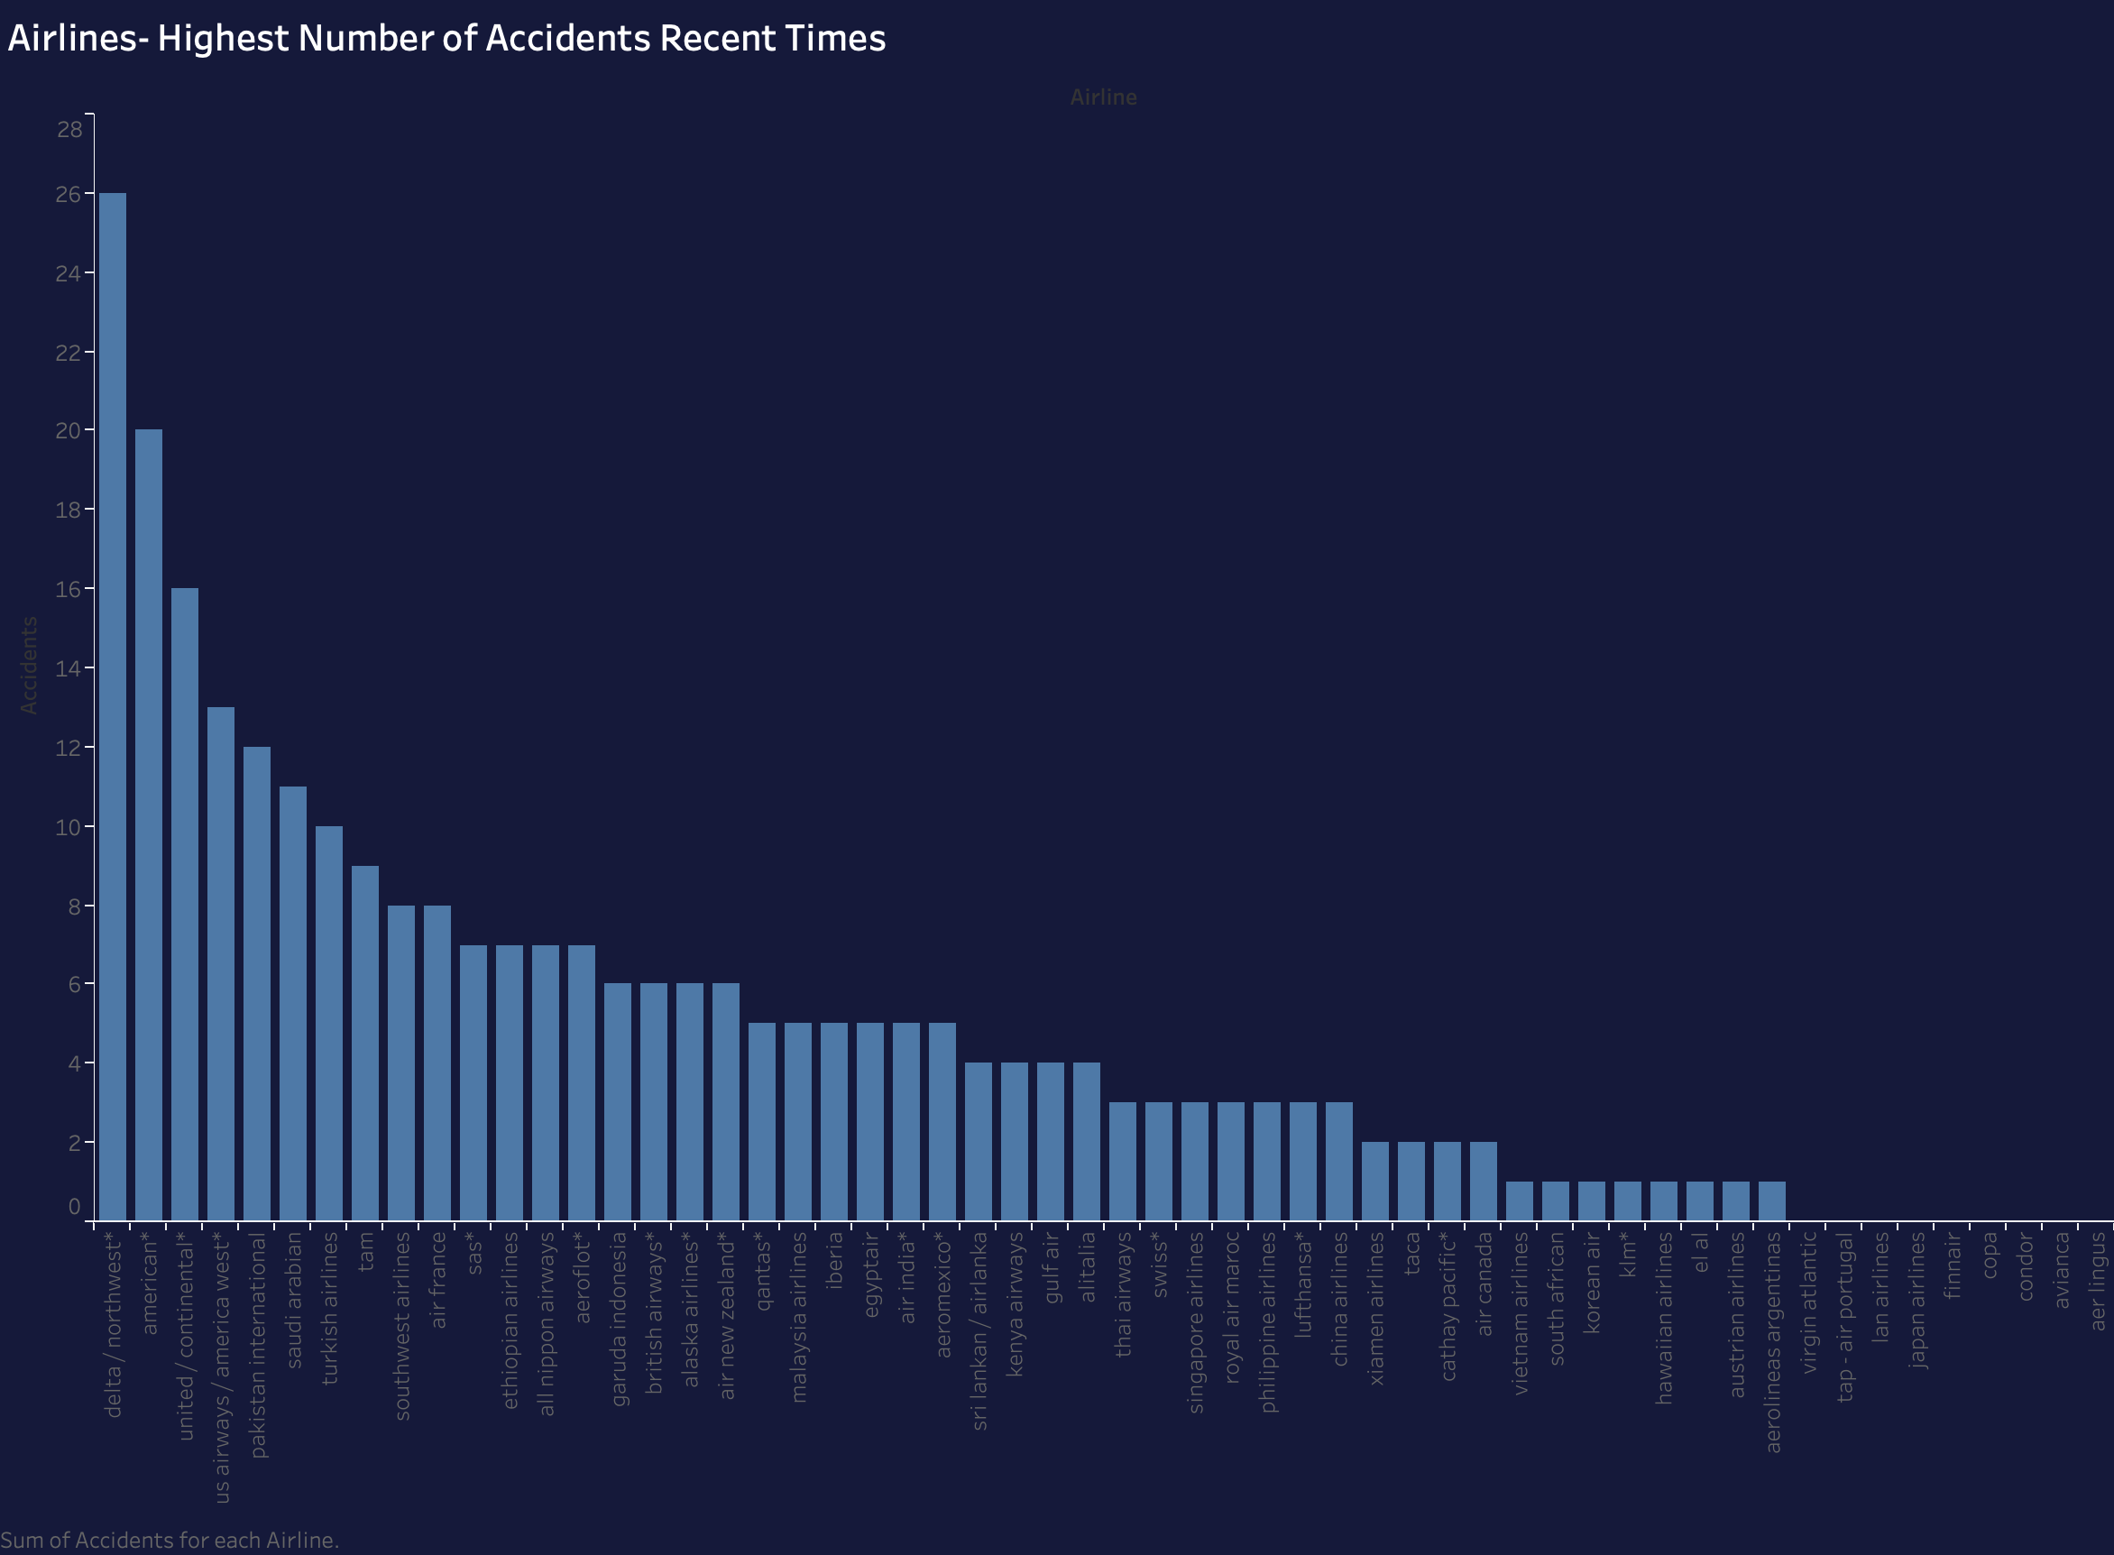

Slide 6
